Slide 1
Planning with Continuous Linear Change: COLIN

Slide 2
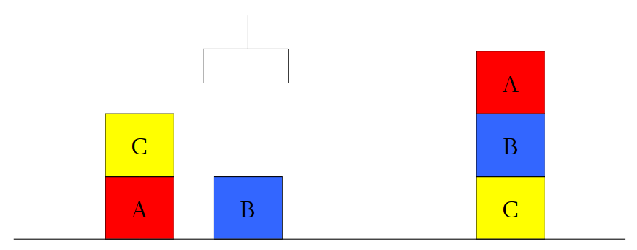
Planning: How it all Started
Initial State: (on C A) (ontable B) (ontable A)
(arm_free) (clear B) (clear C)
Goal: (on B C) (on A B)
(: action pickup_from_block (?b1 ?b2 - block)
:precondition (and (on ?b1 ?b2)
(arm_free))
:effect (and (holding ?b1)
(clear ?b2))
(not (arm_free))
(not (on ?b1 ?b2)))
(: action put_down_on_block (?b1 ?b2 - block)
:precondition (and (holding ?b1)
(clear ?b2))
:effect (and (holding ?b1)
(clear ?b2))
(not (arm_free))
(not (on ?b1 ?b2)))

Slide 3

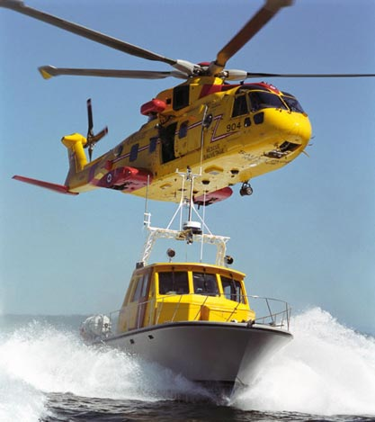
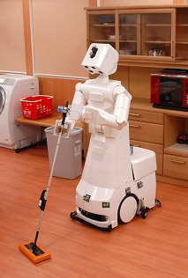
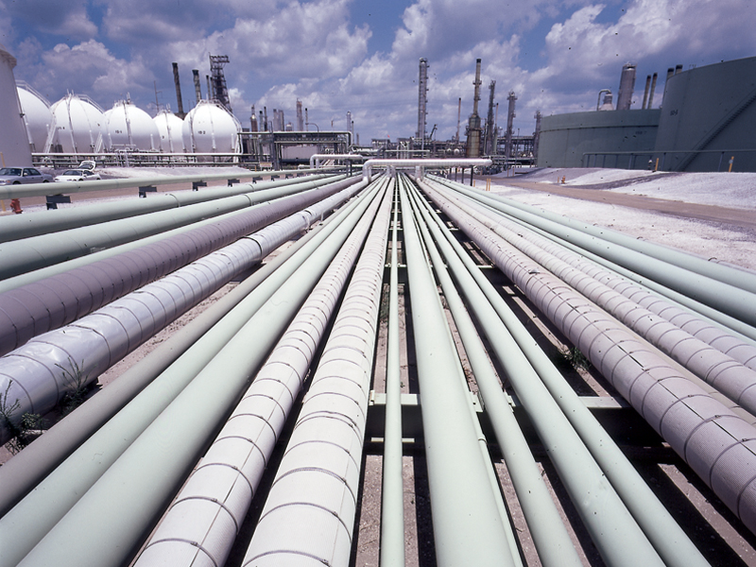
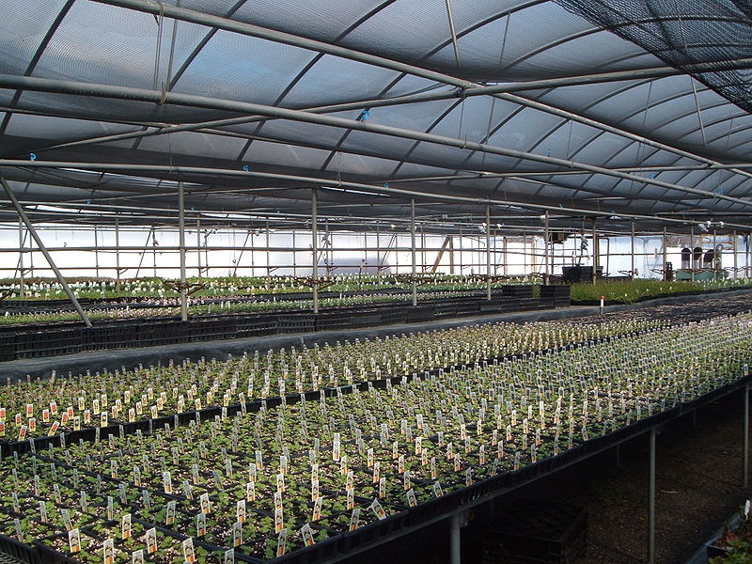


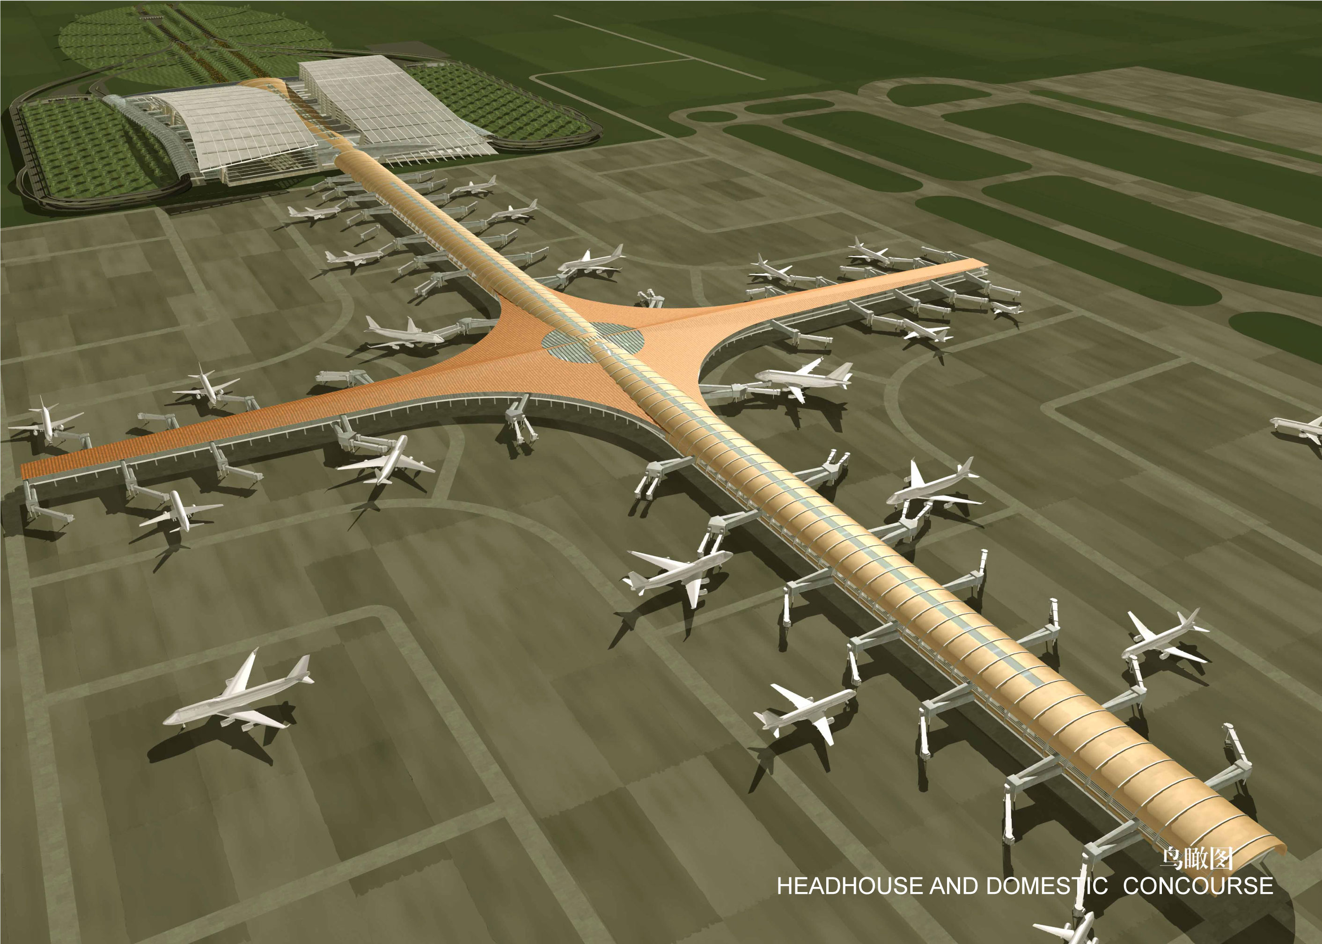
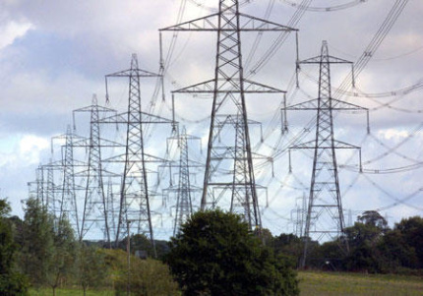
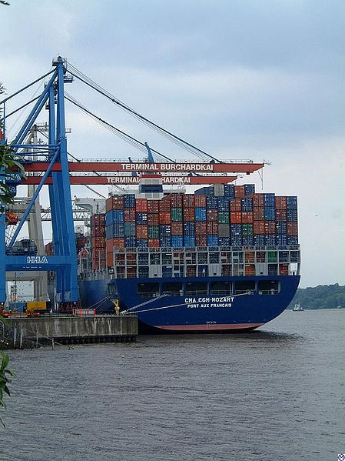
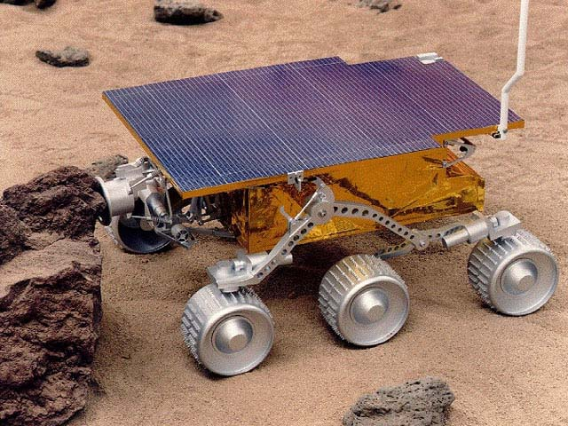
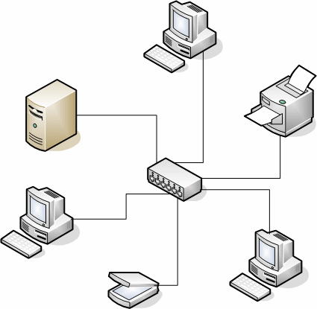
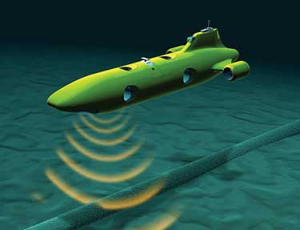
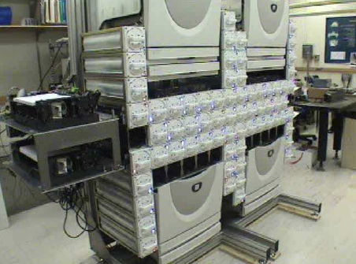
…And where it is Going
What Matters?
Time: Deadlines, Windows of Opportunity;
Numeric Quantities: Discrete and Continuous, Optimisation;
The environment: Uncertainty, Predictable Exogenous Change.

Slide 4
The Reality
State of Charge
Minimum state of charge at nightfall
Solar generation
Demand
Dawn
Nightfall

Slide 5
Classical Planning as Forward Search
TTA
Pickup B
Pickup C
THA
TTH
Put BT
Put BC
Put CB
Put CT
Put CA
TTB
TAA
TTA
TAA
TTT
TTA
TTT
Pickup B
Pickup B
Pickup B
Pickup C
Pickup A
Pickup C
Pickup A
Pickup C
Pickup A
Pickup C
Pickup B
Pickup C
THA
TTH
HTT
THT
TTH
HTB
TTH
HTT
THT
TTH
THA
TTH
...
...
...
...
...
...
...
...
...
...
...
...
Classical Planning Gives Us:
Propositional Relaxation Heuristics: RPG, Causal Graph;
Search Guidance: Helpful Actions/Preferred Operators.
Search Techniques, Enforced Hill-Climbing, Multi Open List Search, Memoisation;

Slide 6
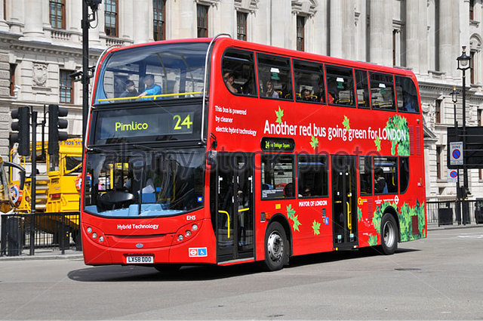
Continuous Linear Change
Numeric quantities so far we have seen change instantaneously:
e.g. (at end (decrease (battery) 1))
(at end (decrease (battery) (+ (*0.5 (temperature)) (*3 (?duration))))
V’ = W . V + C
In reality numeric values often change continuously, rather than discretely.
While the bus is running dbattery/dt = -40
(increase (battery) (*#t -40))
Of course change is not always linear, but that’s another lecture.
Today we will deal with linear change only.
V’ = W . V + C
(
)
(
)
1
-0.5
-3
battery
temperature
duration
.
+ 0
battery’ =

Slide 7
Continuous Linear Change
Numeric quantities so far we have seen change instantaneously:
e.g. (at end (decrease (battery) 1))
(at end (decrease (battery) (+ (*0.5 (temperature)) (*3 (?duration))))
V’ = W . V + C
In reality numeric values often change continuously, rather than discretely.
While the bus is running dbattery/dt = -40
(increase (battery) (*#t -40))
Of course change is not always linear, but that’s another lecture.
Today we will deal with linear change only.

Slide 8
Continuous Linear Change: Colin
duration = 2
Route1 D1 B1
Battery >= 30
R1⊣
At D1 A
R1⊢
At B1 A
Working D1
At D1B
¬At D1 A
Battery >= 10
At B1 B
¬At B1 A
(increase (battery) (*#t -40))
Done Route1
dBattery/dt -=40
-ε
-ε
duration >= 0.25
E1⊢
Run Engine B1
E1⊣
EngineOff B1
On Route B1
EngineOff B1
¬EngineOff B1
Battery <= 100
Cost += 10
dBattery/dt +=60
dCost/dt +=1
50
50
50
R1⊢
E1⊢
E1⊢
R1⊣
E1⊣
R1⊢
R1⊣
E1⊢
E1⊣
E1⊣
R1⊣
"Temporal Planning in Domains with Linear Processes." A. J. Coles, A. I. Coles, M. Fox, and D. Long. IJCAI (2009).
"COLIN: Planning with Continuous Linear Numeric Change." A. J. Coles, A. I. Coles, M. Fox and D. Long. JAIR (44) (2013)

Slide 9
Continuous Linear Change: Colin
duration = 2
Route1 D1 B1
Battery >= 30
R1⊣
R1⊢
Battery >= 10
B_{E1⊢} = B_{R1 ⊢} + (E1⊢ - R1⊢)*-40
B_{E1 ⊢} >= 10
C_{E1⊢} = C’_{R1⊢}
B’_{E1⊢} = B_{E1⊢}
B’_{E1⊢} >= 10, <= 100
C’_{E1⊢} = C_{E1 ⊢} + 10
Temporal
Constraints:
R1⊣ - R⊢ = 2
E1 ⊢ >= R1⊢ + ε
E1⊣ - E1⊢ >= 0.25
R1 ⊣ >= E1 ⊣ + ε
dBattery/dt -=40
-ε
-ε
duration >= 0.25
E1⊢
Run Engine B1
E1⊣
Battery <= 100
Cost += 10
dBattery/dt +=60
dCost/dt +=1
Numeric Constraints:
B_{E1⊣} = B_{E1⊢} + (E1⊣ - E1⊢)*20
B_{E1⊣} >= 10, <=100
C_{E1⊣} = C’_{R1⊢} + (E1⊣ - E1⊢) * 1
B’_{E1⊣} = B_{E1 ⊣}
B’_{E1⊣} >= 10
C’_{E1⊣} = C_{E1 ⊣}
R1⊢
E1⊢
E1⊣
R1⊣
B_{R1⊢} = 50
B_{E1⊢}=B’_{R1⊢}+(E1⊢-R1⊢)*-40
B_{E1⊣}=B’_{E1⊢}+(E1⊣-E1⊢)*20
B_{R1⊣}=B’_{E1⊣}+(R1⊣-E1⊣)*-40
B’_{E1⊢}=B_{E1⊢}
B’_{E1⊣} = B_{E1 ⊣}
B’_{E1⊣}= B_{E1⊣}
B’_{R1⊢}=B_{R1⊢}
B’_{R1⊢} >= 10
B_{E1 ⊢} >= 10
B’_{E1⊣} >= 10
B_{E1⊣} >= 10
B’_{E1⊣} >= 10
B_{R1⊣} >= 10
B_{R1⊣} = B_{E1⊣} + (R1⊣ - E1⊣)*-40
B_{R1⊣} >= 10, >= 30
C_{R1⊣} = C’_{E1 ⊣}
B’_{R1⊣} = B_{E1 ⊣},
B’_{R1⊣} >= 10, <= 100
C’_{R1⊣} = C_{E1 ⊣}
B’_{E1⊣} <= 100
B_{E1⊣} <= 100
B_{R1⊣} >= 30
"Temporal Planning in Domains with Linear Processes." A. J. Coles, A. I. Coles, M. Fox, and D. Long. IJCAI (2009).
"COLIN: Planning with Continuous Linear Numeric Change." A. J. Coles, A. I. Coles, M. Fox and D. Long. JAIR (44) (2013)

Slide 10
Continuous Linear Change: Colin
duration = 2
Route1 D1 B1
Battery >= 30
R1⊣
R1⊢
Battery >= 10
B_{E1⊢} = B_{R1 ⊢} + (E1⊢ - R1⊢)*-40
B_{E1 ⊢} >= 10
C_{E1⊢} = C’_{R1⊢}
B’_{E1⊢} = B_{E1⊢}
B’_{E1⊢} >= 10, <= 100
C’_{E1⊢} = C_{E1 ⊢} + 10
Temporal
Constraints:
R1⊣ - R⊢ = 2
E1 ⊢ >= W⊢ + ε
E1⊣ - E1⊢ >= 0.25
R1 ⊢ >= E1⊢ + ε
dBattery/dt -=40
-ε
-ε
duration >= 0.25
E1⊢
Run Engine B1
E1⊣
Battery <= 100
Cost += 10
dBattery/dt +=60
dCost/dt +=1
Numeric Constraints:
B_{E1⊣} = B_{E1⊢} + (E1⊣ - E1⊢)*20
B_{E1⊣} >= 10, <=100
C_{E1⊣} = C’_{R1⊢} + (E1⊣ - E1⊢) * 1
B’_{E1⊣} = B_{E1 ⊣}
B’_{E1⊣} >= 10
C’_{E1⊣} = C_{E1 ⊣}
R1⊢
E1⊢
E1⊣
R1⊣
C_{R1⊢} = 0
C_{E1⊢}=C’_{R1⊢}
C_{E1⊣}=C’_{E1⊢}+(E1⊣-E1⊢)*1
C_{R1⊣}=C’_{E1⊣}
C’_{E1⊢}=C_{E1⊢}+10
C’_{E1⊣} = C_{E1 ⊣}
C’_{E1⊣}= C_{E1⊣}
C’_{R1⊢}=C_{R1⊢}
B_{R1⊣} = B_{E1⊣} + (R1⊣ - E1⊣)*-40
B_{R1⊣} >= 10, >= 30
C_{R1⊣} = C’_{E1 ⊣}
B’_{R1⊣} = B_{E1 ⊣},
B’_{R1⊣} >= 10, <= 100
C’_{R1⊣} = C_{E1 ⊣}
"Temporal Planning in Domains with Linear Processes." A. J. Coles, A. I. Coles, M. Fox, and D. Long. IJCAI (2009).
"COLIN: Planning with Continuous Linear Numeric Change." A. J. Coles, A. I. Coles, M. Fox and D. Long. JAIR (44) (2013)

Slide 11
Linear Programming
General form:
Maximise: z = w_{z} .v
Subject to:
w₁ .v {≤, ≥, =} c₁
w₂ .v {≤, ≥, =} c₂
...
w_{n} .v {≤, ≥, =} c_{n}

